Slide 1
BRITISH AIRWAYS
Insights from web scraping of customer reviews from skytrax

Slide 2
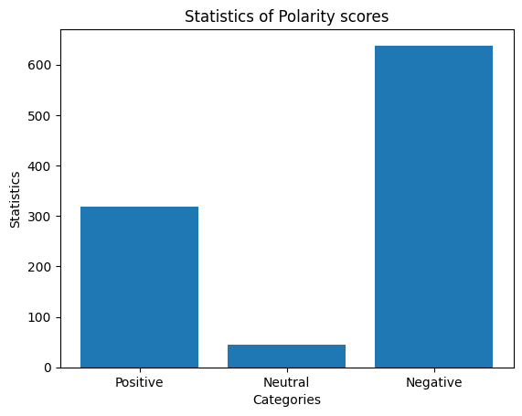
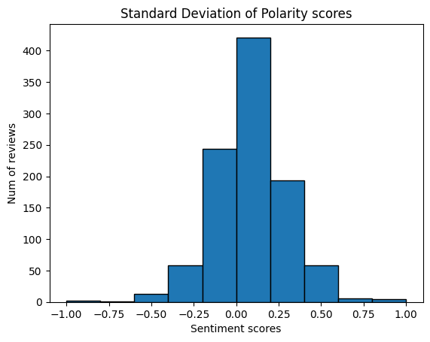
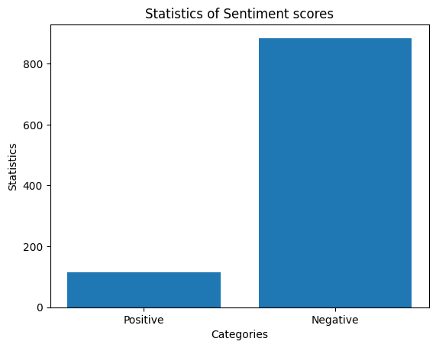
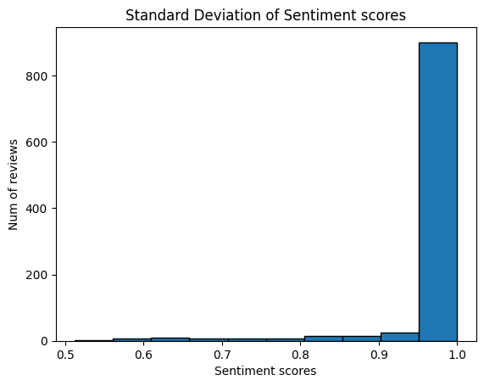
Sentiment analysis of reviews
Sentiment Analysis using Text Blob
Sentiment Analysis using Transformer-based pipeline

Slide 3
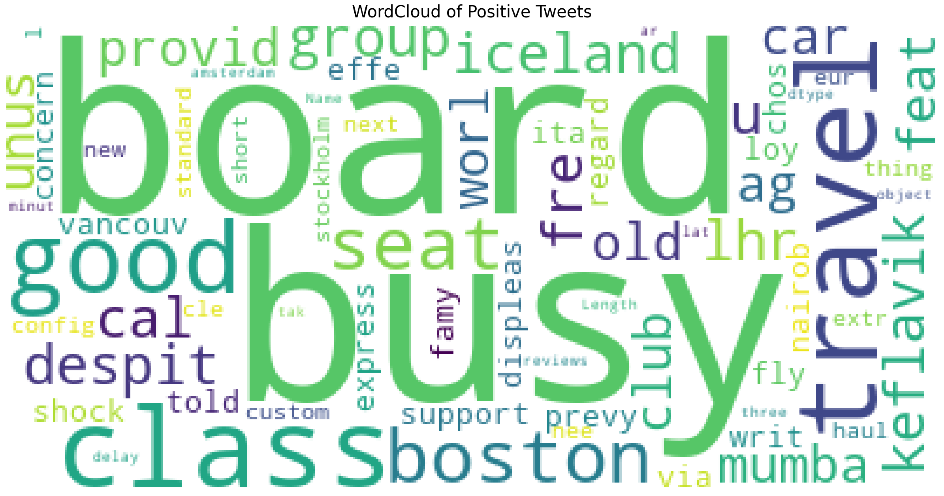
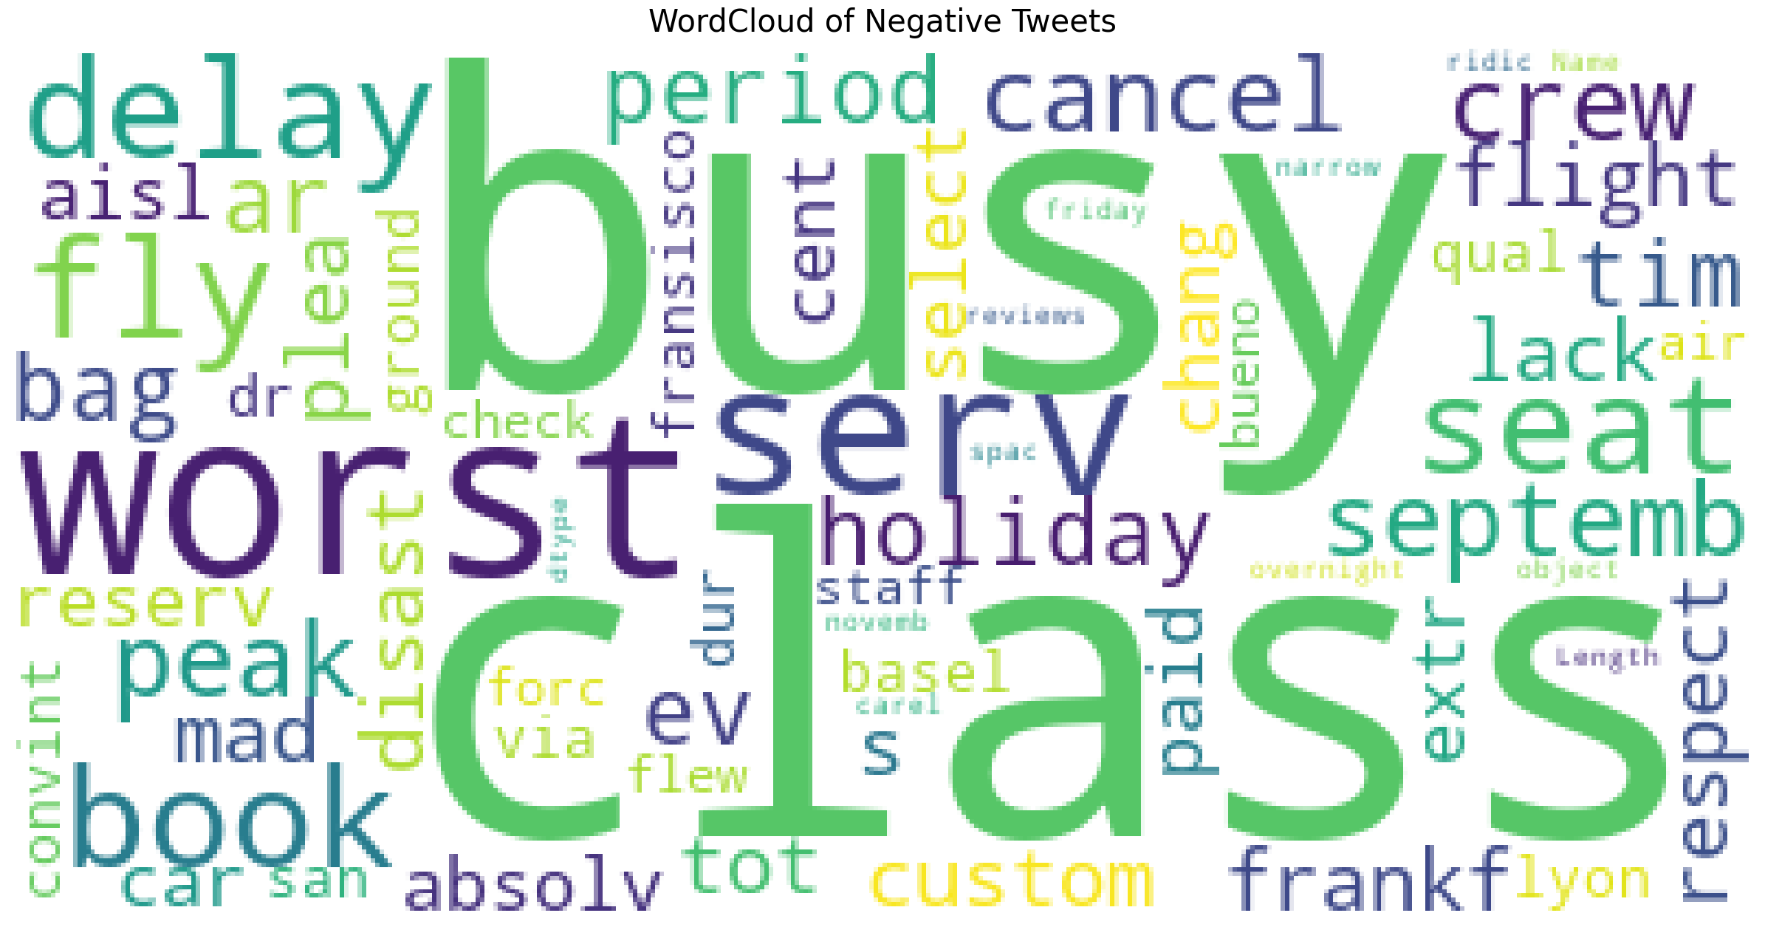
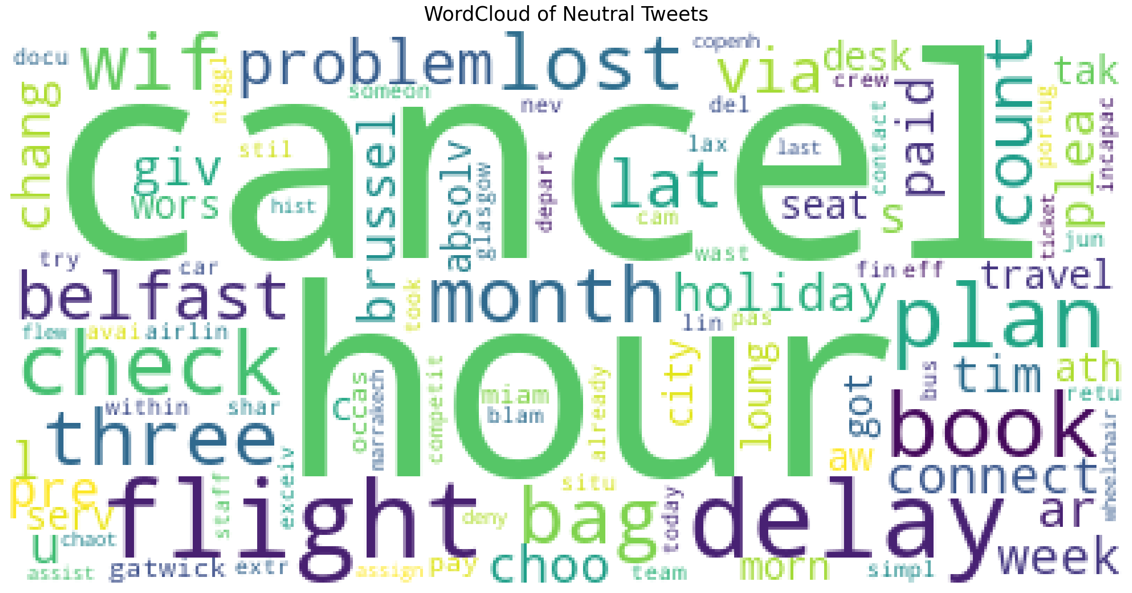
Word cloud representation of positive, neutral and negative reviews

